Slide 1


The Frontier of Multimodal Reasoning
Speaker: Wenhu Chen

Slide 2
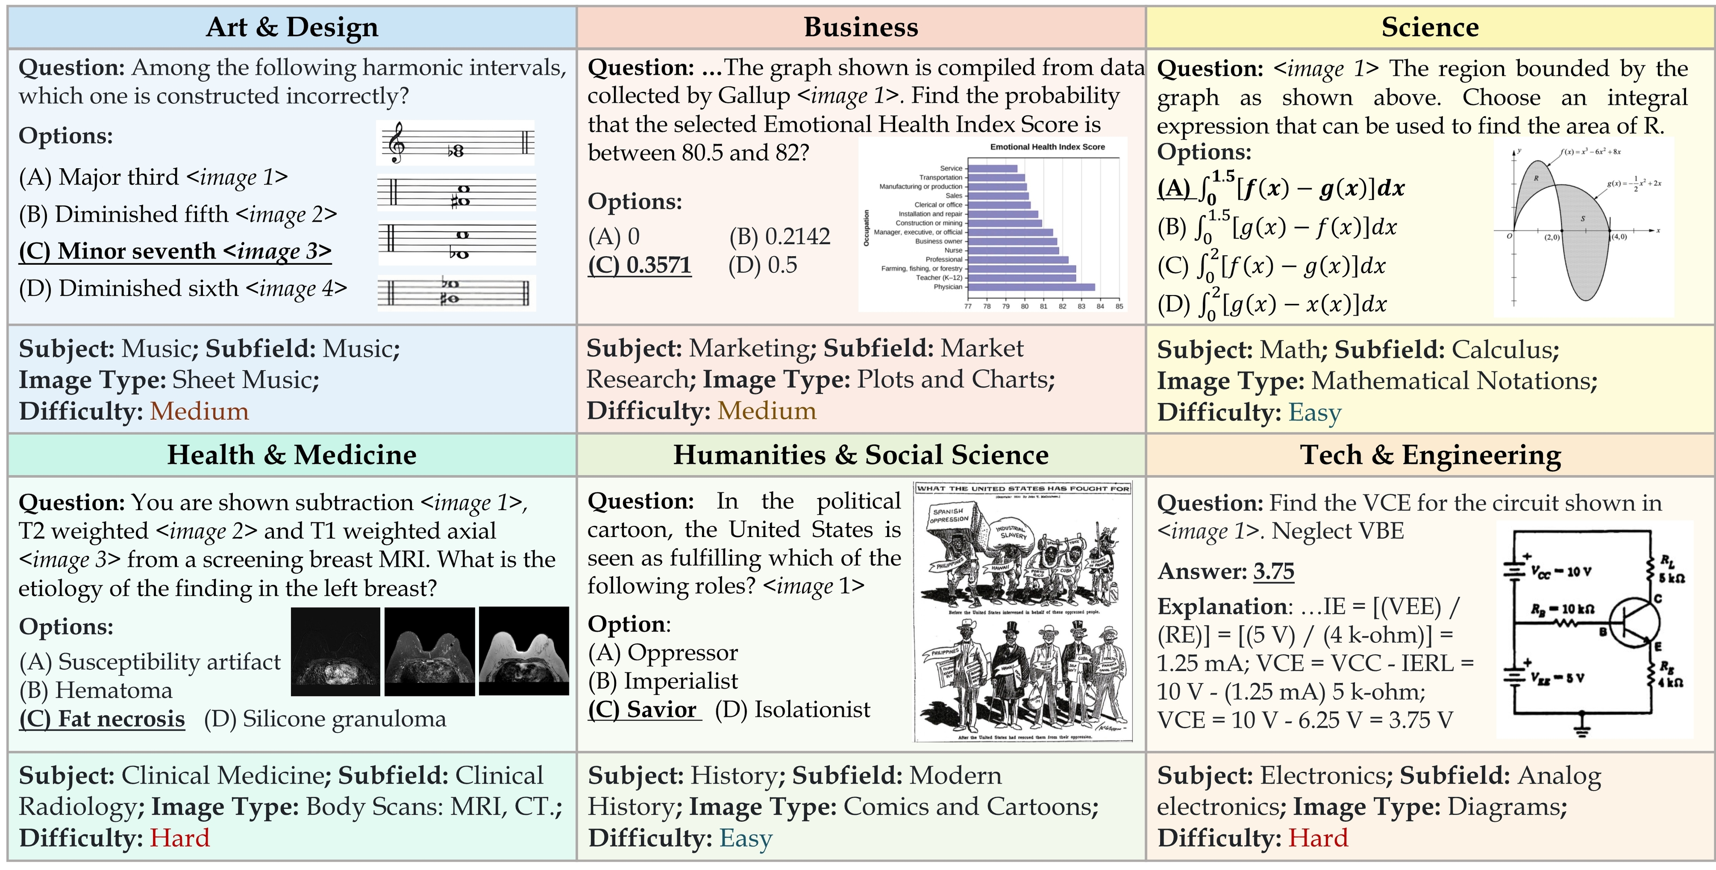
Multimodal Reasoning Across Fields

Slide 3
Talk Overview
Multimodal
Supervised Fine-Tuning
Multimodal
Reinforcement Learning
Multimodal
Agents

Slide 4
Sec 1: Multimodal Supervised Fine-Tuning
VisualWebInstruct: Scaling up Multimodal Instruction Data through Web Search

Slide 5
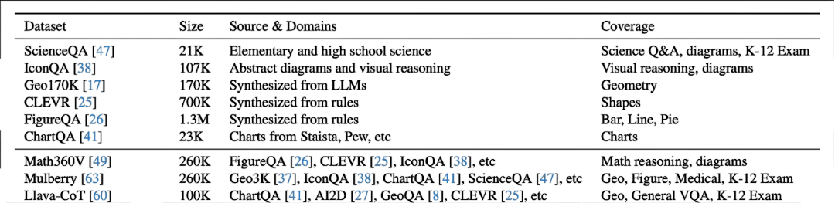
Existing Training Dataset
Issues of the existing datasets:
The existing datasets are mostly focused on narrow domains.
Many of these datasets are synthesized by rules.
The difficulty level is mostly in primary school level.

Slide 6


Annotating Reasoning Data is Expensive!
VQA
STEM VQA
Affordable
Unaffordable

Slide 7


Finding Free Reasoning Data on the Web!

Slide 8
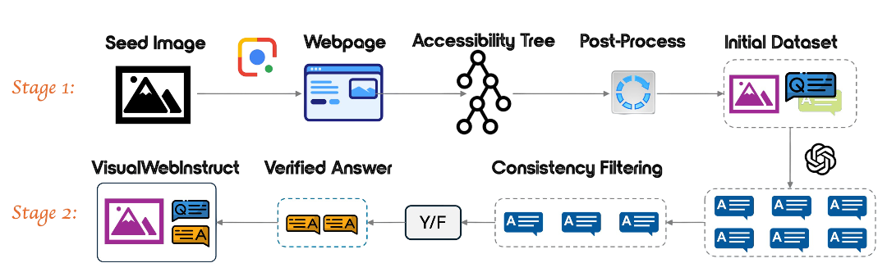
How to Identify These Questions?

Slide 9
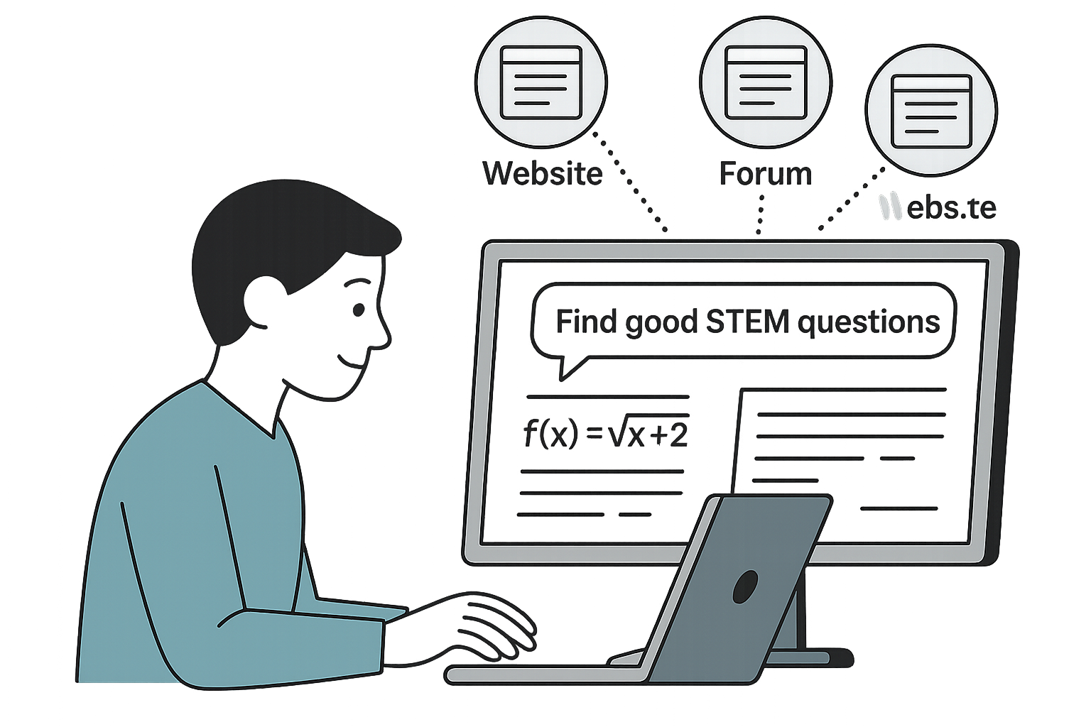
Stage 1.1: Collecting Seed Images
We need reasonable scale seed images to start with.
Balance different disciplines.
Distribute the work to multiple authors.
Identify good websites to crawl the images.

Slide 10
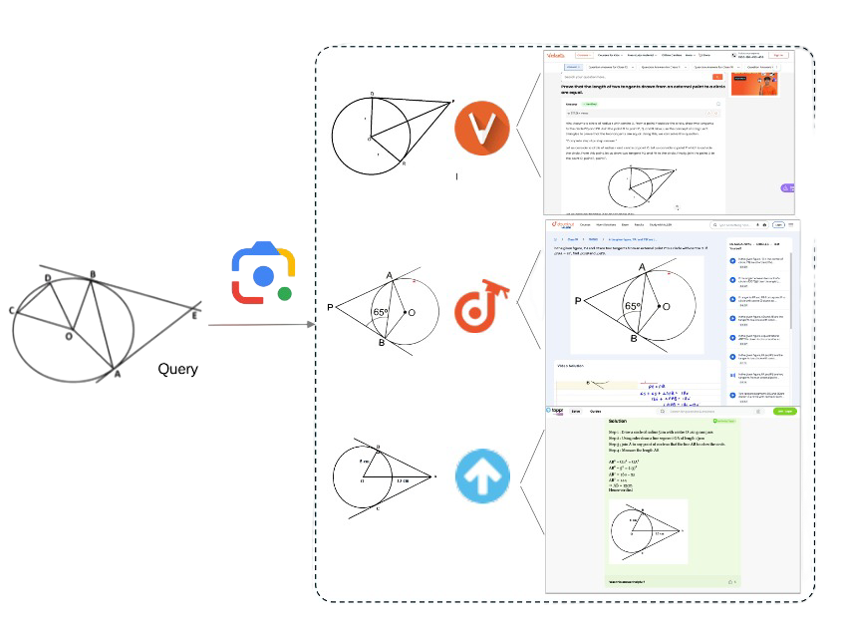
Stage 1.2: Utilizing Google Lens Search

Slide 11
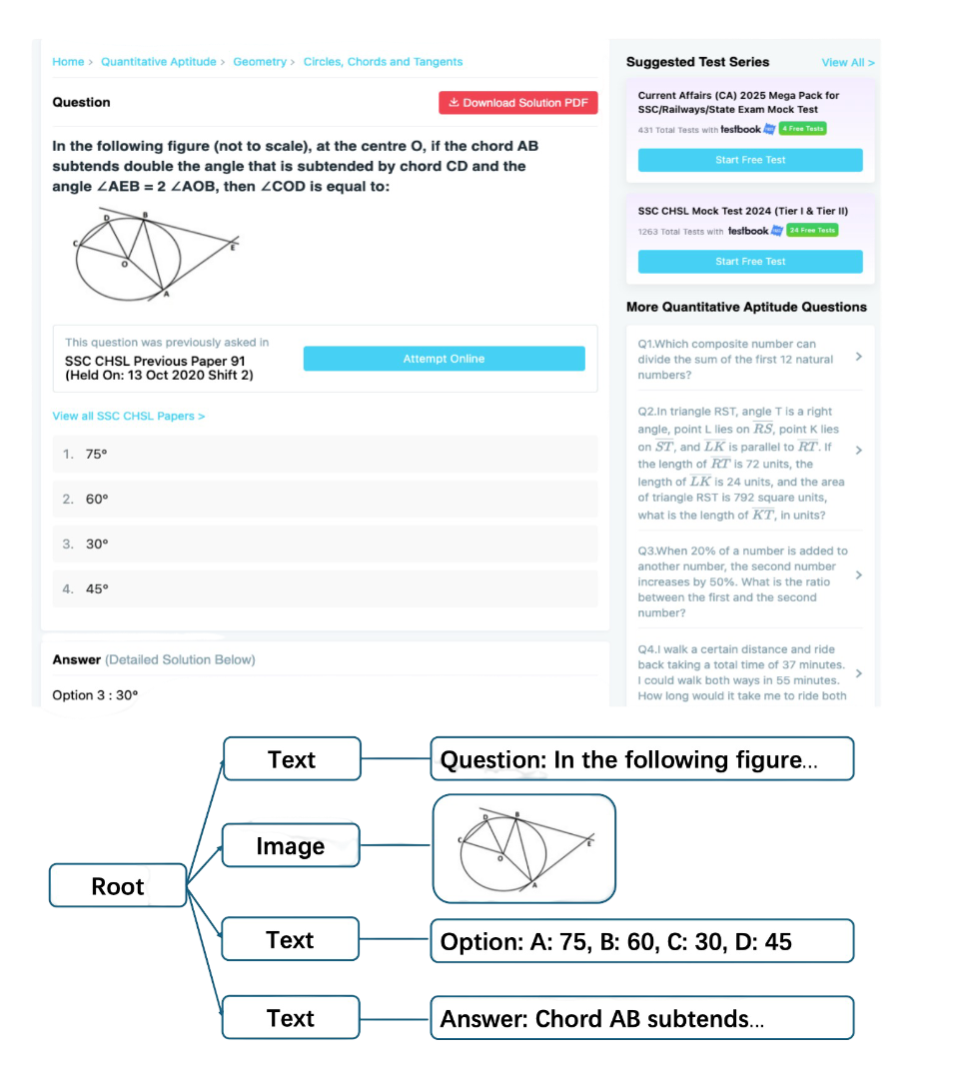
Stage 1.3: Parsing Accessibility Tree
Extract Meaning Text and Image
Organize the content as a Tree
Greatly Reduce Tokens

Slide 12

Stage 1.4: Image-Question-Answer Extraction

Slide 13
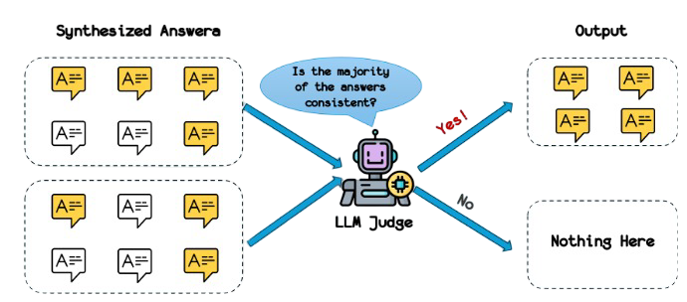
Stage 2.1: Answer Refinement
We need to refine the extracted answers.
Generate multiple responses with GPT-4o
Compare multiple responses to find their consensus.

Slide 14

Stage 2.2: Answer Alignment
If the answer can be found on the website.
Use the provided answer as reference.
This step ensure accuracy of generated answers.
match

Slide 15
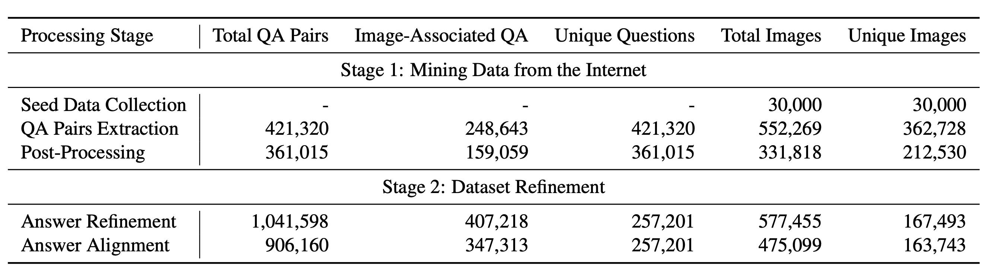
Processing Details

Slide 16
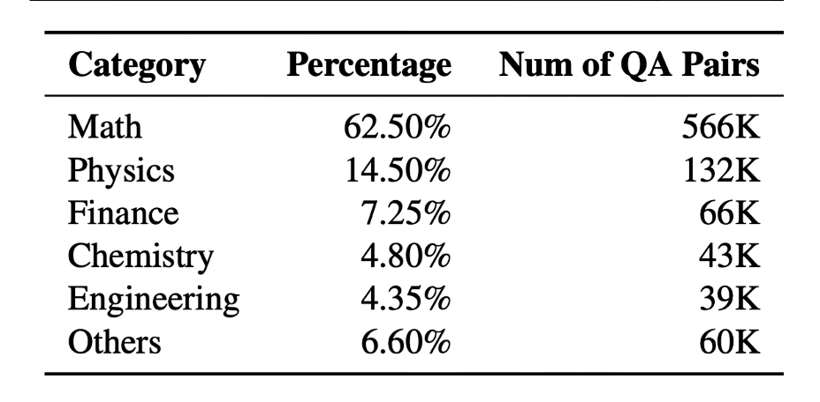
Dataset Statistics
30K Seed Images.
900K instruction Dataset.
347K with images.
553K without images.

Slide 17
Training Details
900K VisualWebInstruct.
100K Llava-CoT.
Training from MAmmoTH-VL.
Training on 8xA100 GPUs.
Input Image resolution is 384x384.
Sequence Length is 8K tokens.

Slide 18
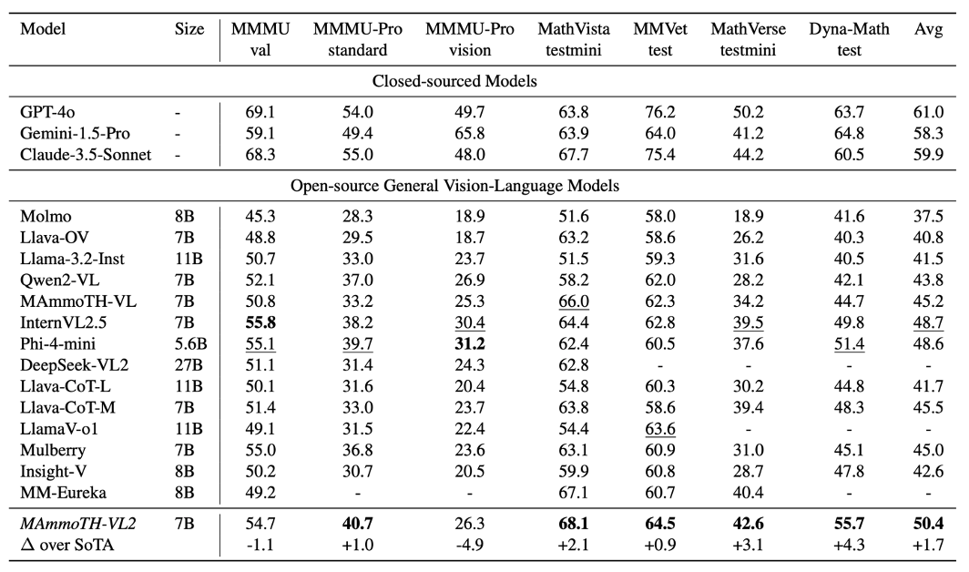
Experimental Results

Slide 19
Sec 2: Multimodal Reinforcement Learning
VL-Rethinker: Incentivizing Self-Reflection of Vision-Language Models with Reinforcement Learning

Slide 20
Multimodal Reasoning
SFT training is restrictive, which cannot incentivize VLMs’ internal reasoning capabilities. Therefore, the gain is limited.
We need reinforcement learning to incentivize that.
Most visual question answering has short answers, like option, string, number, etc. These are easy-to-verify format.

Slide 21
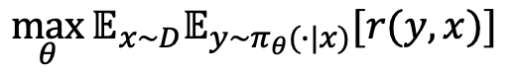
Problem Formulation
Given a multimodal input consisting of one or more images I and a textual query Q, the goal is to generate a textual response y.
We aim to optimize the end reward on a given dataset D.
$$\max_{θ}{𝔼_{x\sim D}𝔼_{y\sim π_{θ}(∙|x)}[r(y,x)]}$$

Slide 22
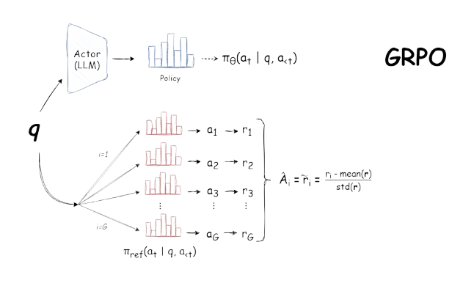
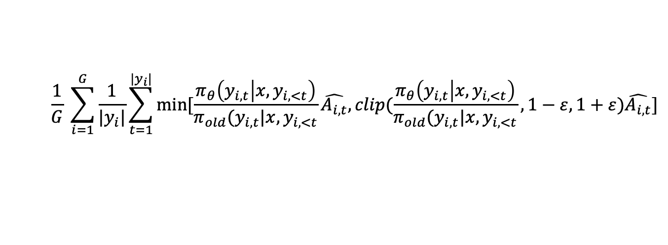
Group Relative Preference Optimization
$$\frac{1}{G} \sum_{i=1}^{G}{\frac{1}{|y_{i}|}\sum_{t=1}^{|y_{i}|}{min⁡[\frac{π_{θ}\left(y_{i,t} | x,y_{i,<t}\right)}{π_{old}(y_{i,t}|x,y_{i,<t}}\hat{A_{i,t}}, clip(\frac{π_{θ}\left(y_{i,t} | x,y_{i,<t}\right)}{π_{old}(y_{i,t}|x,y_{i,<t}}, 1−ε,1+ε)\hat{A_{i,t}}]}}$$

Slide 23
Existing Results with Multimodal RL
Directly RL on multimodal models is not as effective.
Negative Results:
MathVista => GPT-o1: 74% vs. Qwen2.5-VL-72B: 74.8%
MathVerse => GPT-o1: 57% vs. Qwen2.5-VL-72B: 57.4%
More:
QVQ-72B: 71.4% vs. Qwen2-VL-72B: 70.5% on MathVista

Slide 24
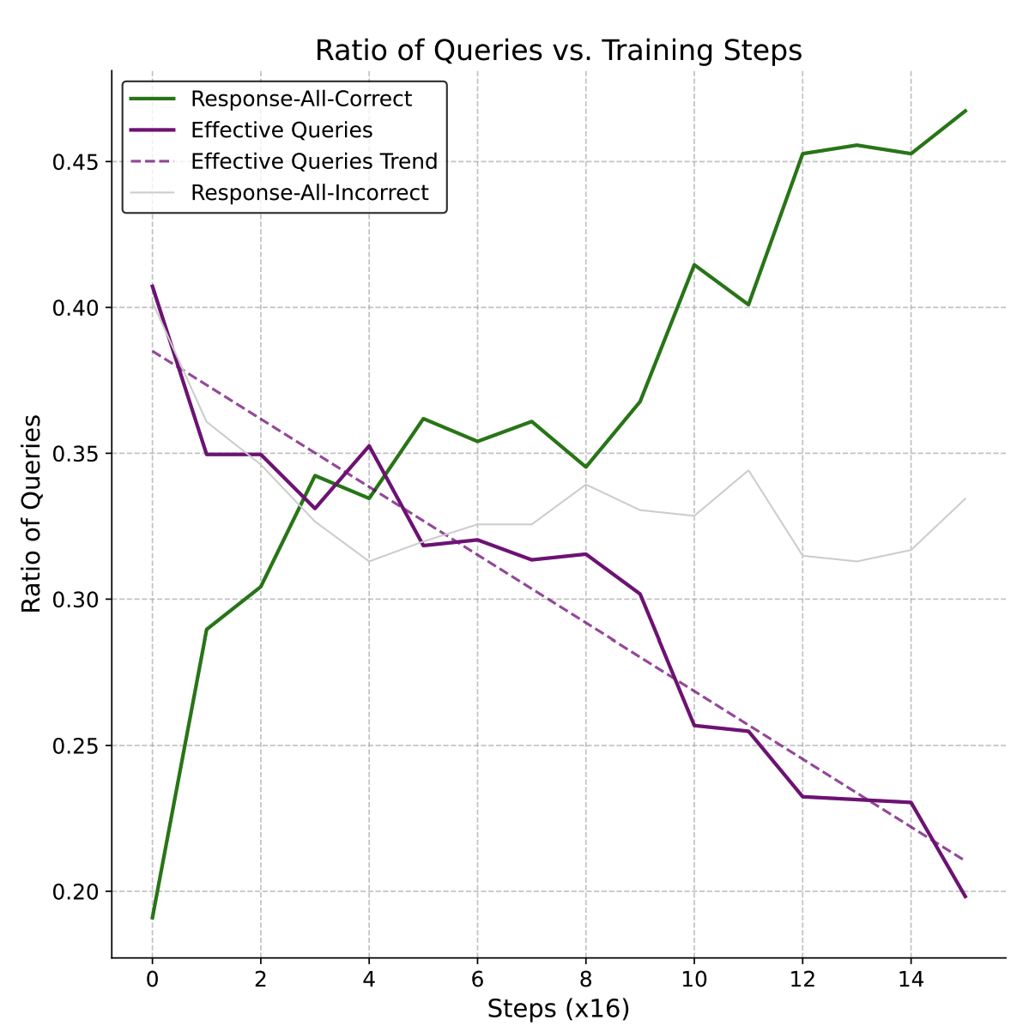
Issue 1: Vanishing Advantages
Advantages are calculated within the group.
On easy questions, all the responses are correct, so the advantages are zero
On hard questions, all the responses are wrong, so the advantages are also zero.
Without advantage, the gradient becomes zero, the model stops learning

Slide 25
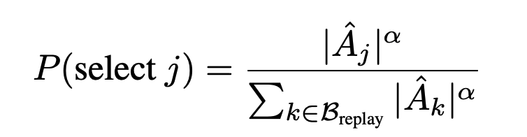
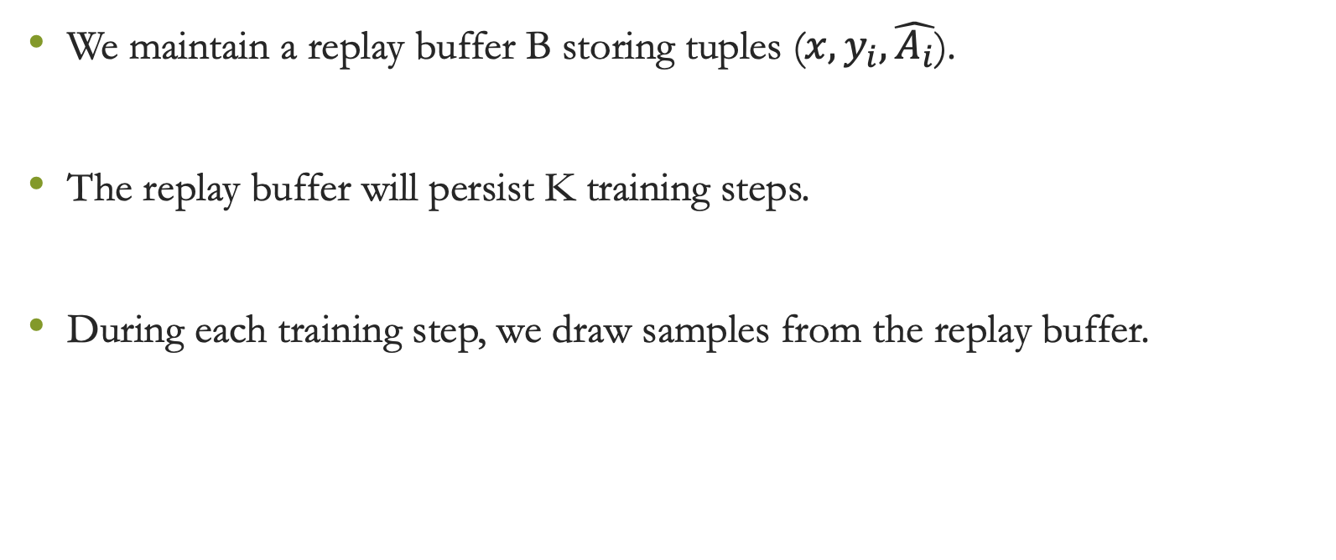
Our Approach: Selective Sample Replay
We maintain a replay buffer B storing tuples ($x,y_{i},\hat{A_{i}}$).
The replay buffer will persist K training steps.
During each training step, we draw samples from the replay buffer.

Slide 26
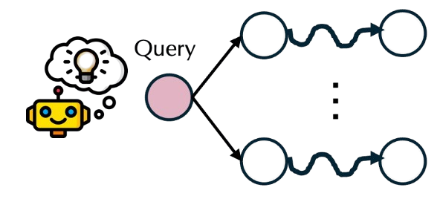
Issue 2: Non-Reflection
Text-only training can trigger self-reflection and self-verification easily. We can observe test time scaling with longer output sequence.
However, in multimodal training, we do not observe the emergence of self-reflection and self-verification.

Slide 27
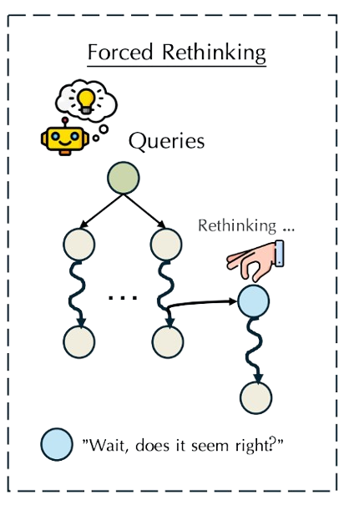
Our Approach: Forced Rethinking
Simple Solution:
1. Do normal response rollouts.
2. Append “wait” token at the end
3. Continue generation

Slide 28
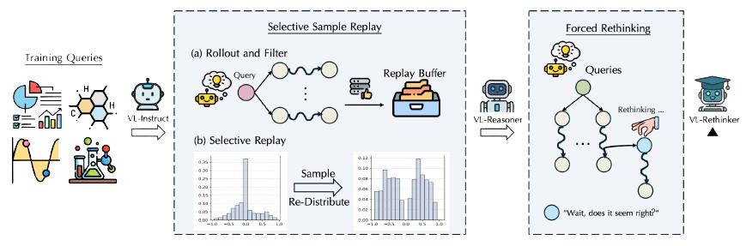
Entire Framework: VL-Rethinker
1. We first train VL-Reasoner with SSR.
2. We continue to train with Forced Rethinking Strategy.

Slide 29
Training Details
Training Dataset (16K)
Virgo, R1-Onevision, MM-Eureka
Filtering Mechanism: these 16K samples are filtered through pre-processing to discard examples too hard or too simple.
Evaluation Dataset
Math: MathVista, MathVerse, MathVision
Multi-discipline: MMMU, MMMU-Pro, EMMA
Mega-Bench
Training for 3 epochs with rollout size=8.

Slide 30
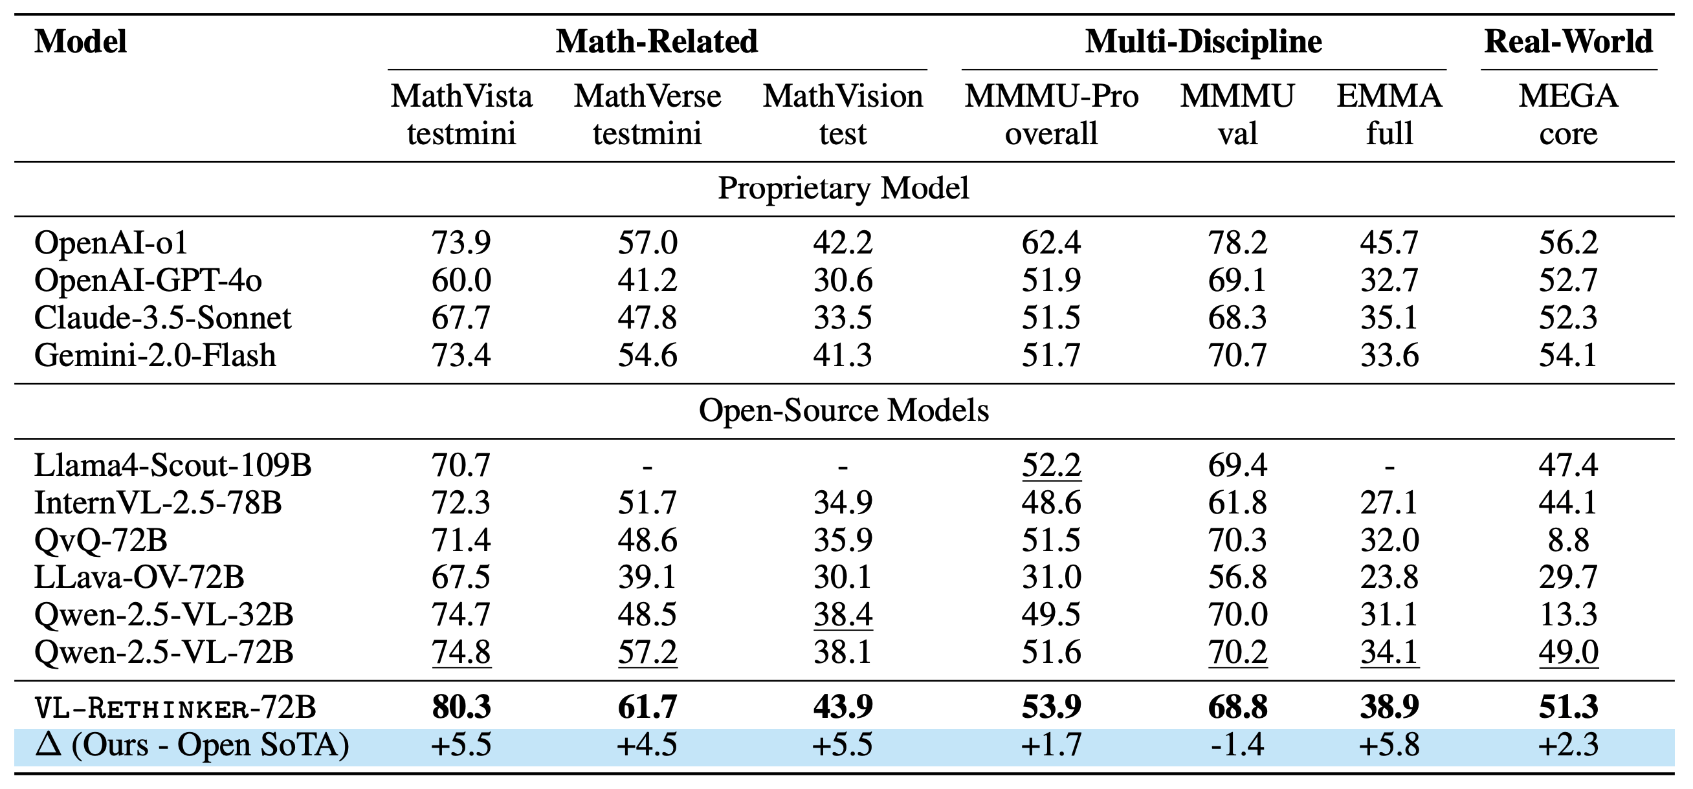
Experimental Results (72B)

Slide 31
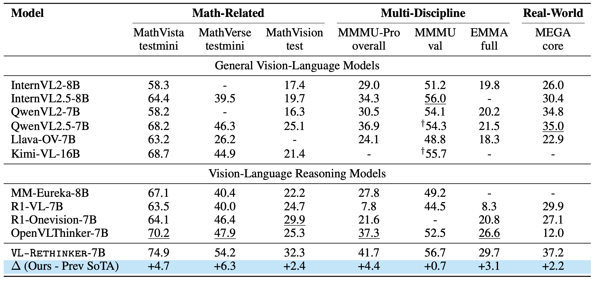
Experimental Results (7B)

Slide 32
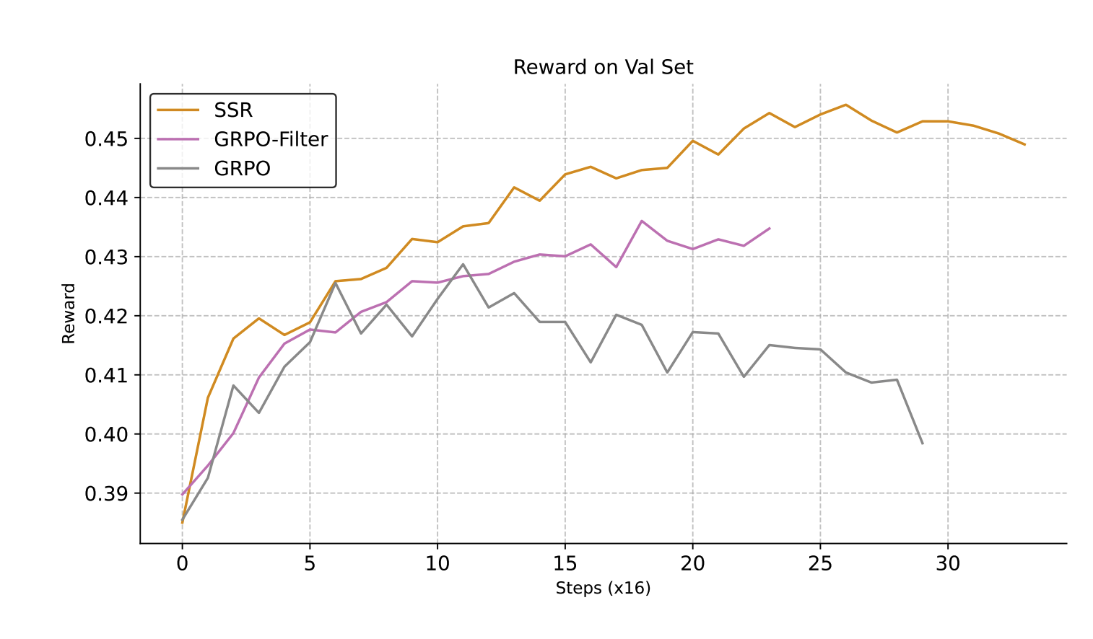
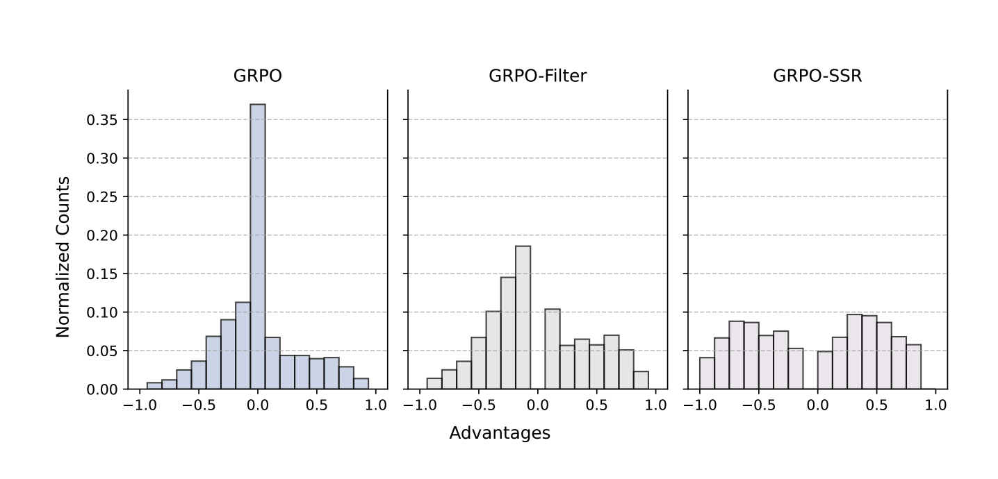
Ablation of SSR

Slide 33
Sec 3: Multimodal Tool Use
Pixel Reasoner: Incentivizing Reasoning in the Pixel Space with Reinforcement Learning

Slide 34
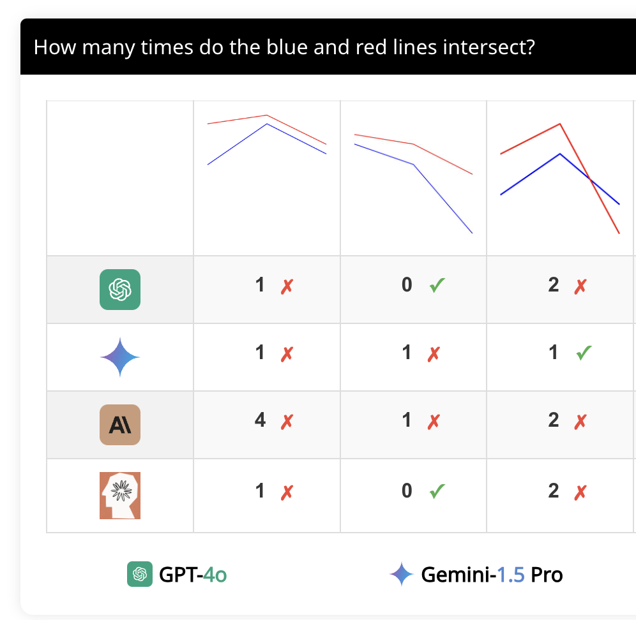

Status Quo of Multimodal Reasoning
Most Reasoning is happening in the text side.
Lack of Reasoning in Pixel Space.
100,000 tokens
Vision Enc
1000 tokens
Vision Enc
Reasoning VLMs

Slide 35
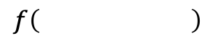
Expanding Pixel Context
Expanding the Pixel Context
Feeding Transformed Pixel Information
100 tokens
Vision Enc
$$f\left( \right)$$
1000 tokens
Vision Enc
Vision Enc
Reasoning VLMs

Slide 36

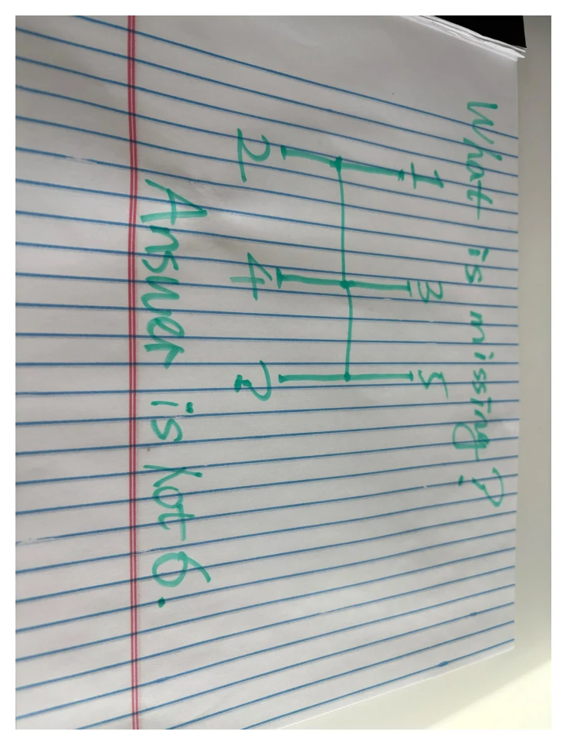

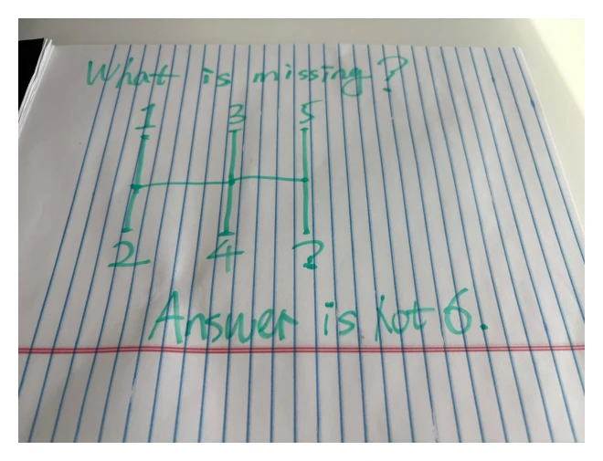
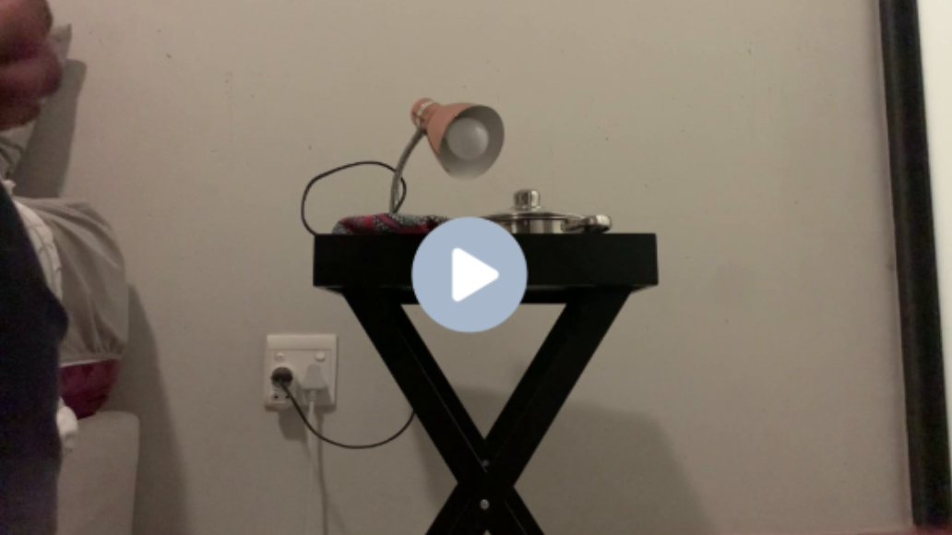
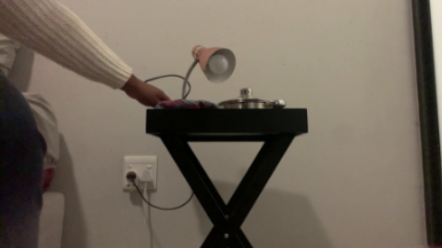
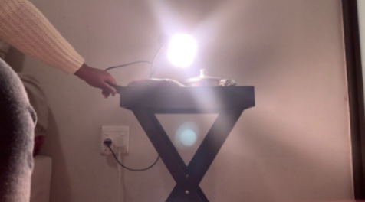
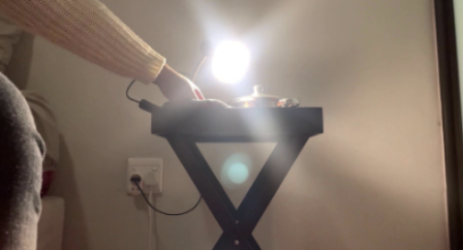
Visual Functions & Operations
zoom-in
rotate
frame-select

Slide 37
Training Data Curation Pipeline
Q: What’s written on the notebook?
GPT-4o
A: 4th February – finish roadmap.
Local Bounding Box
Images

Slide 38
GRPO with Pixel Functions
Directly Training with GRPO will fail:
The model is not willing to explore pixel operations.
The success rate is low and the model fails to get enough reward.
Solution:
Warm-start with synthetic SFT data.
RL with curiosity-driven reward -> Incentivize the pixel operation with rewards.

Slide 39
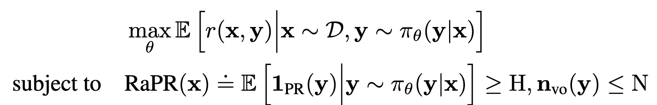
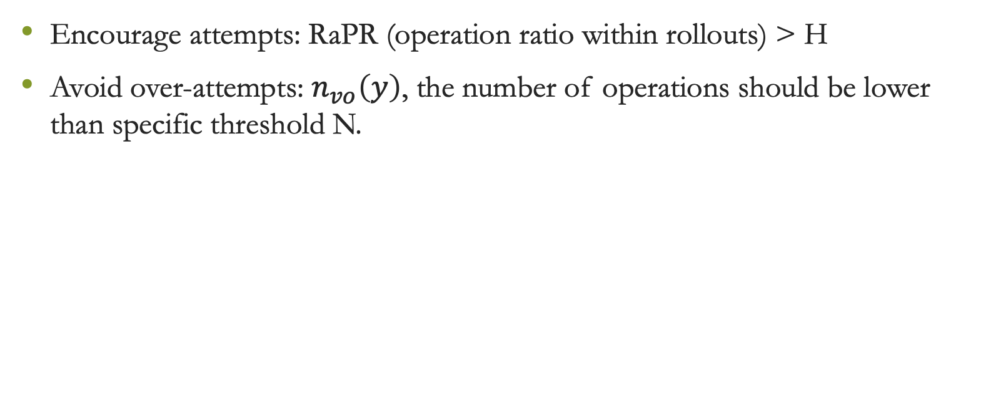
Balancing Exploration and Exploitation
Encourage attempts: RaPR (operation ratio within rollouts) > H
Avoid over-attempts: $n_{vo}\left(y\right)$, the number of operations should be lower than specific threshold N.

Slide 40
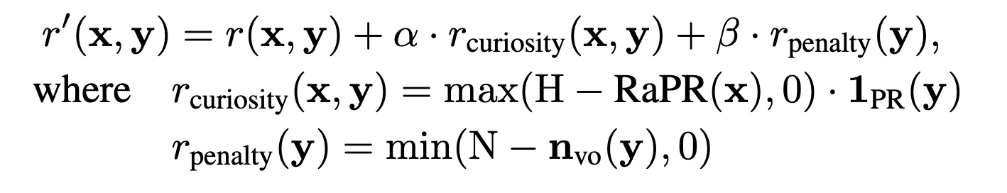
Relaxation: Reward Shaping
Within the groups having lower than H-percent pixel operations, we reward the individual rollouts with operations.
We punish the rollout that over-uses pixel operations to hack rewards.

Slide 41
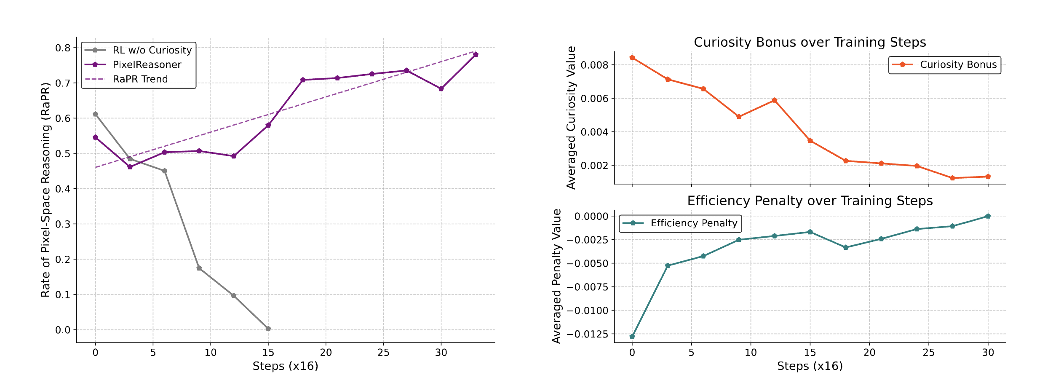
The Effects of Curiosity-Driven RL

Slide 42
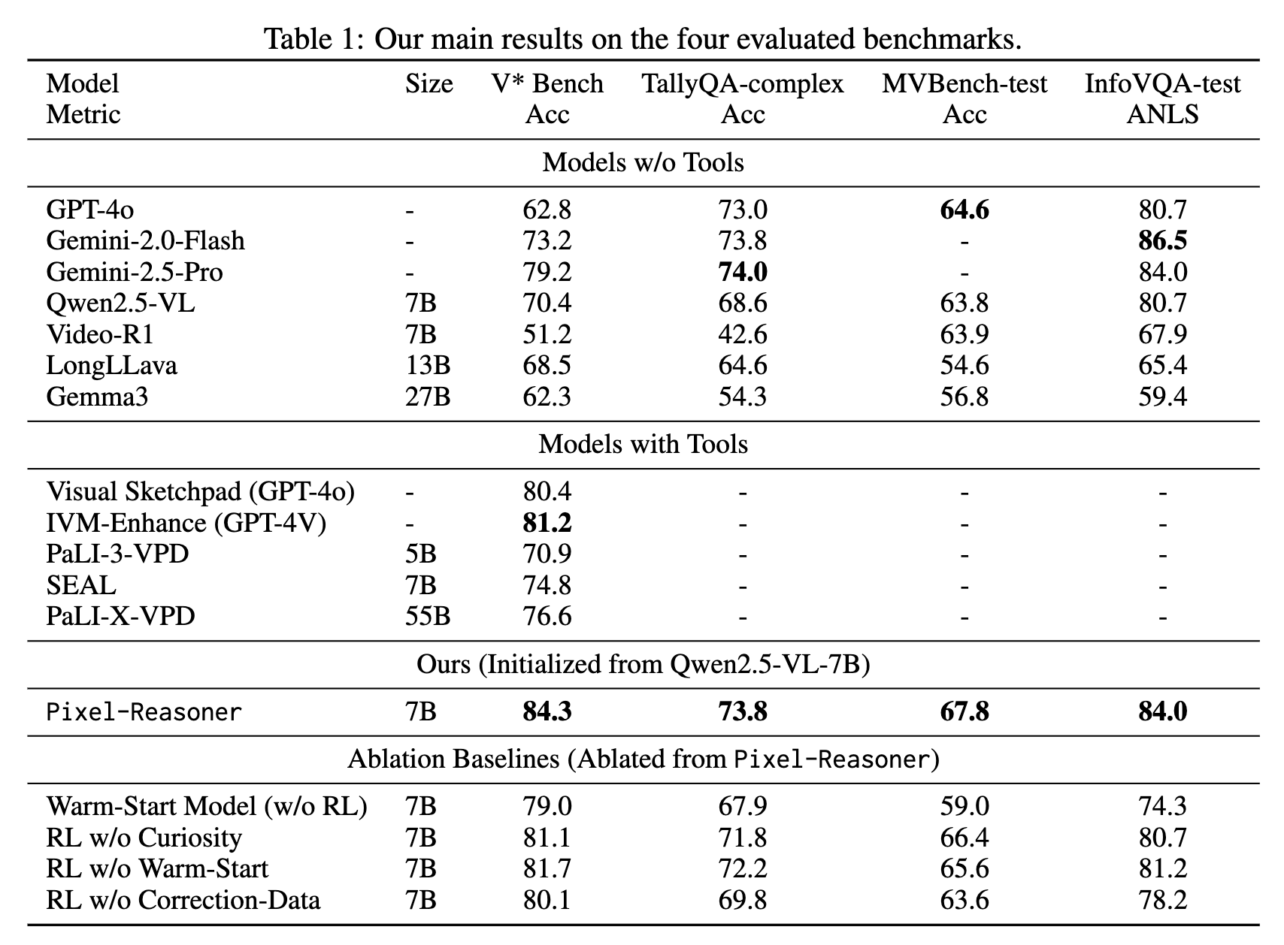
Experimental Results

Slide 43
Takeaways
Section 1:
We can utilize Google Search to scale up multimodal reasoning dataset from the Internet. These dataset can complement existing ones well.
Section 2:
We can force VLM to re-think and balance the rollout distribution to empower VLMs to perform more deliberate long thinking.
Section 3:
We can incentivize the VLMs to utilize pre-defined visual operations in the reasoning process to enhance perception. This is effective with curiosity rewards.

Slide 44

Q&A

